Slide 1

Path Variables Validation
Postman client
SpringBootDemo
DB
https://www.mkyong.com/spring-boot/spring-rest-validation-example/
Consuming a RESTful Web Services by using Postman client
Create/Update/Get/delete/Get list of Employee details

Slide 2
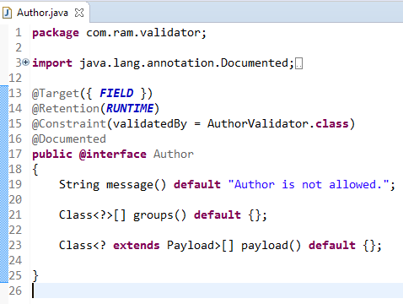
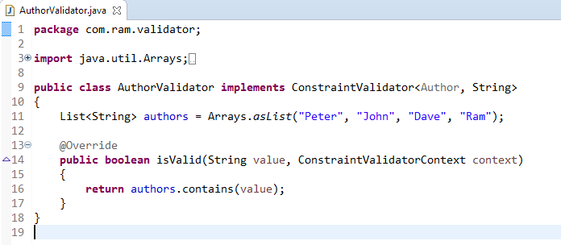
Spring REST Validation Example - Custom Validator
1
We will create a custom validator for the author field, only allowing 4 authors to save into the database.
2

Slide 3
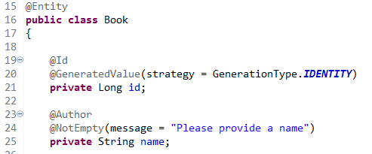
Spring REST Validation Example - Custom Validator
If the custom validator is failed, it will trigger a MethodArgumentNotValidException
3

Slide 4
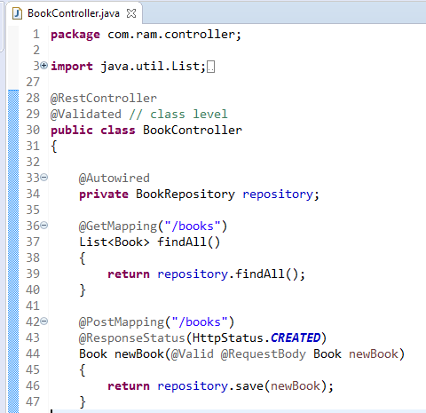
Spring REST Validation Example - Custom Validator
4
Apply @Validated on class level, and add the javax.validation.constraints.* annotations on path variables

